Slide 1

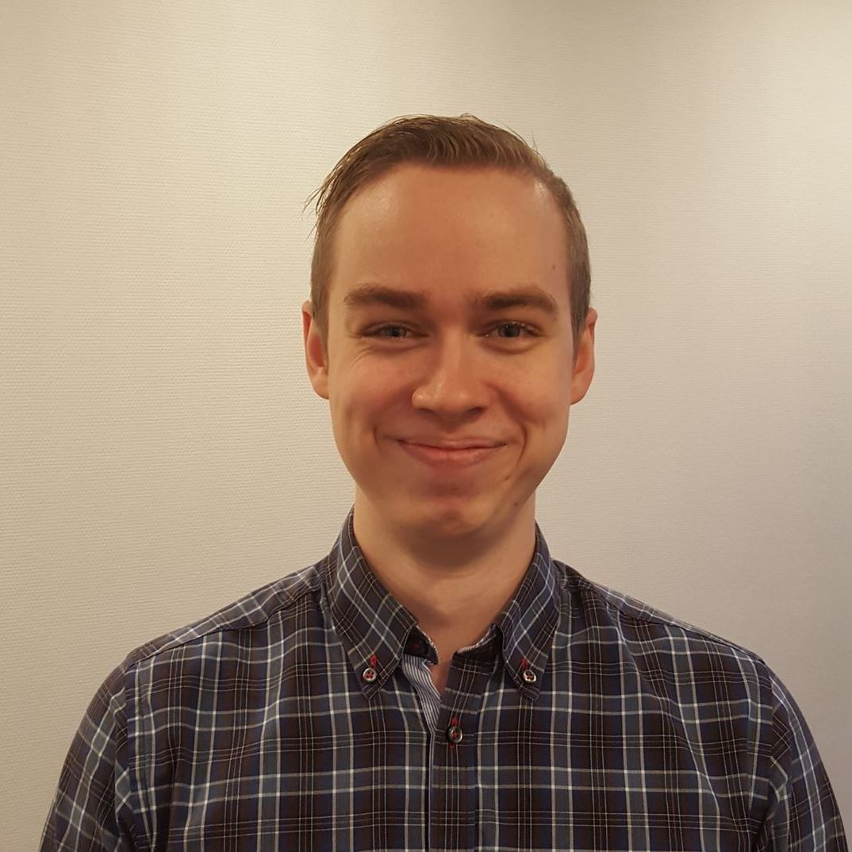


The
Archi
tects
Notes:
Ramuld

Slide 2
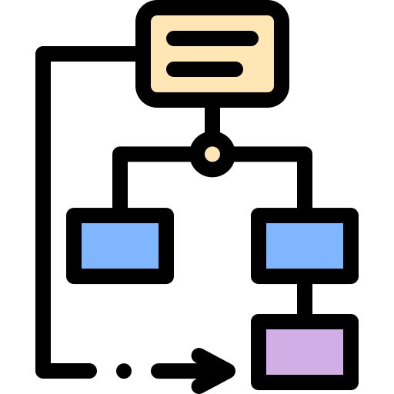



Agenda
A to Z Overview
In-depth with Bet placement
In-depth with 3+1
In-depth with aSQA
Notes:
JACOB

Slide 3

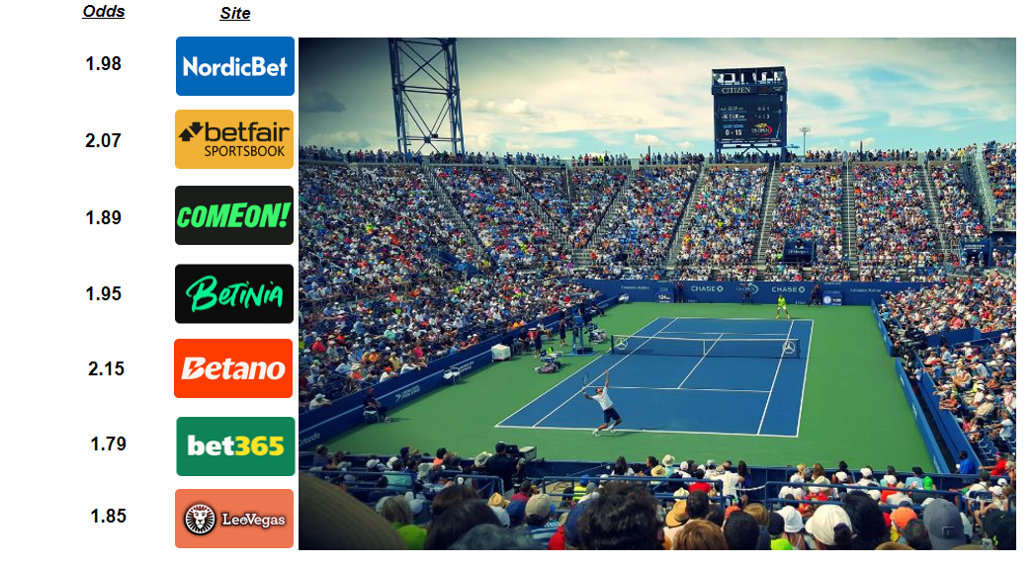
Notes:
JACOB

Slide 4

Analysis
ASR’s
Qualities
Performance
Modifiability
Safety
World cups
Many odds updated
Many logins
Many bets to forward
Bookmakers
Remove
Add
Changing API
Bets placement
Odds change before confirmation
Different thresholds
Scenarios:
Usability
Not prioritized:
Branding
Settings supporting favourite teams
Site preferring matches by favourite teams
Notes:
JACOB
Stakeholders such as major sports clubs, and their desire for branding was not prioritized

Slide 5

Synthesis
3+1 = ASR
Module viewpoint = used package diagram view…to show X Y Z
Component connector viewpoint = used component diagram view
Allocation viewpoint = used deployment diagram view…to show X Y Z
Notes:
THOR

Slide 6

Prototype
Early validation of patterns/tactics
Validation of quality “performance”
Experimental prototype.
Load balancer
Validation of quality “Safety”:
Exploratory
Actor model
Notes:
RAMULD

Slide 7

Evaluation
Notes:
RAMULD

Slide 8
In-depth with bet-placement & prototype
Notes:
JACOB

Slide 9
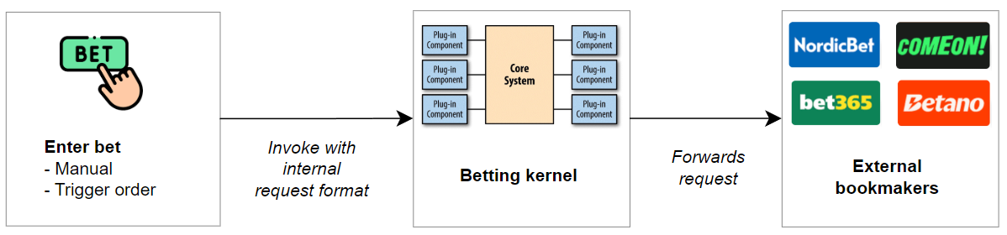
Zooming in on Bet placement
Notes:
Jacob

Slide 10
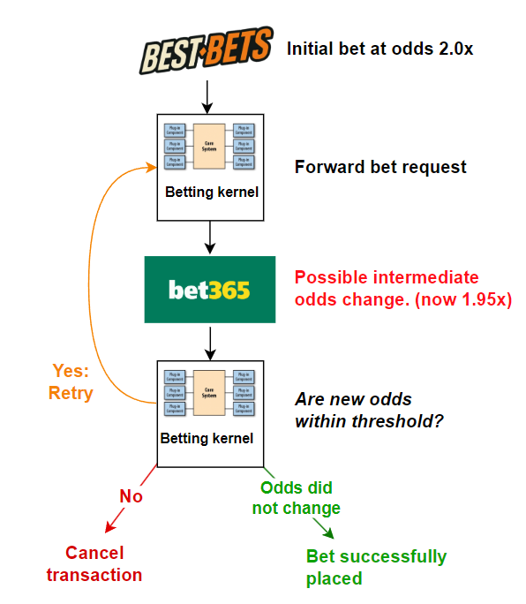
Transaction - Start of transaction: Initial bet placement
- End of transaction: Final confirmation/rejection
Tactic:
Notes:
Ramuld

Slide 11
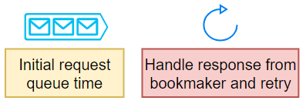
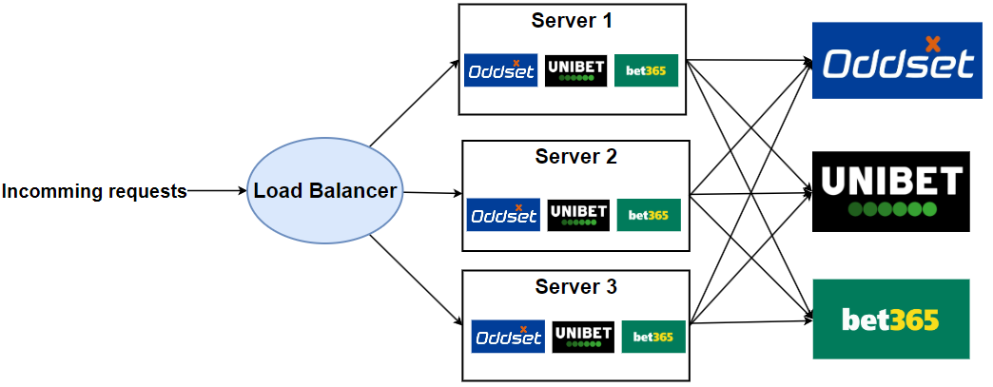
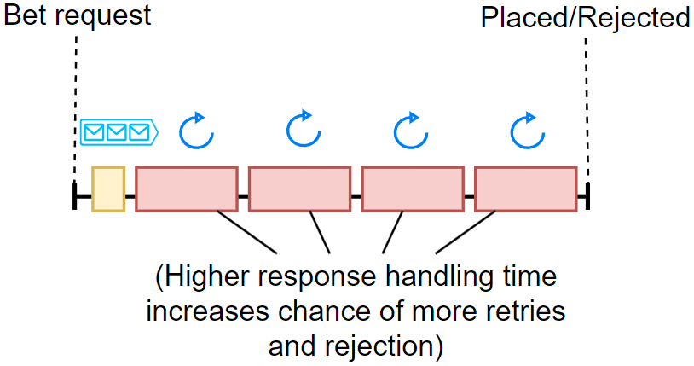
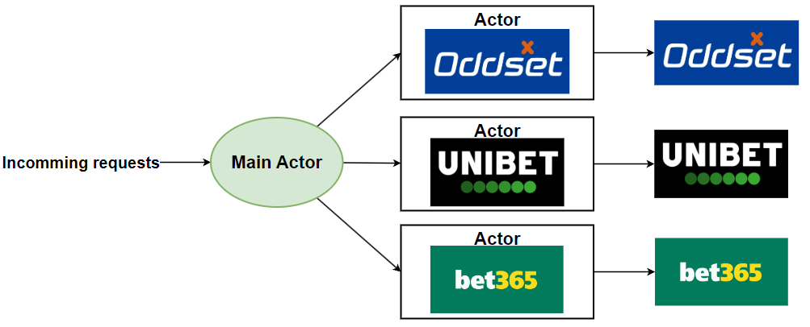
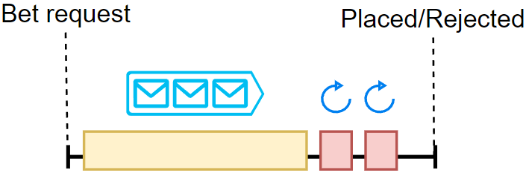
Patterns:
Load balancer for performance
Actor model for bet safety
Notes:
Jacob slides
Load balancer: Experimental
Actor: Exploratory
When main actor is ready for you, It will spin up a “personal actor” making the retries fast.
Load balancer:

Slide 12
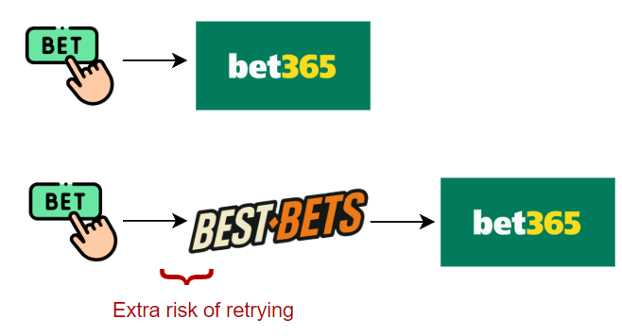
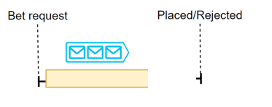
Pause for a second - Why is this important?
If our site is the cause of bet rejections, people would just use the bookmakers directly
Our patterns solve different problems
90 % of the times, only initial wait time is important and
10 % the retry time is very important.
With only a load balancer it could potentially struggle with placing most bets.

Slide 13
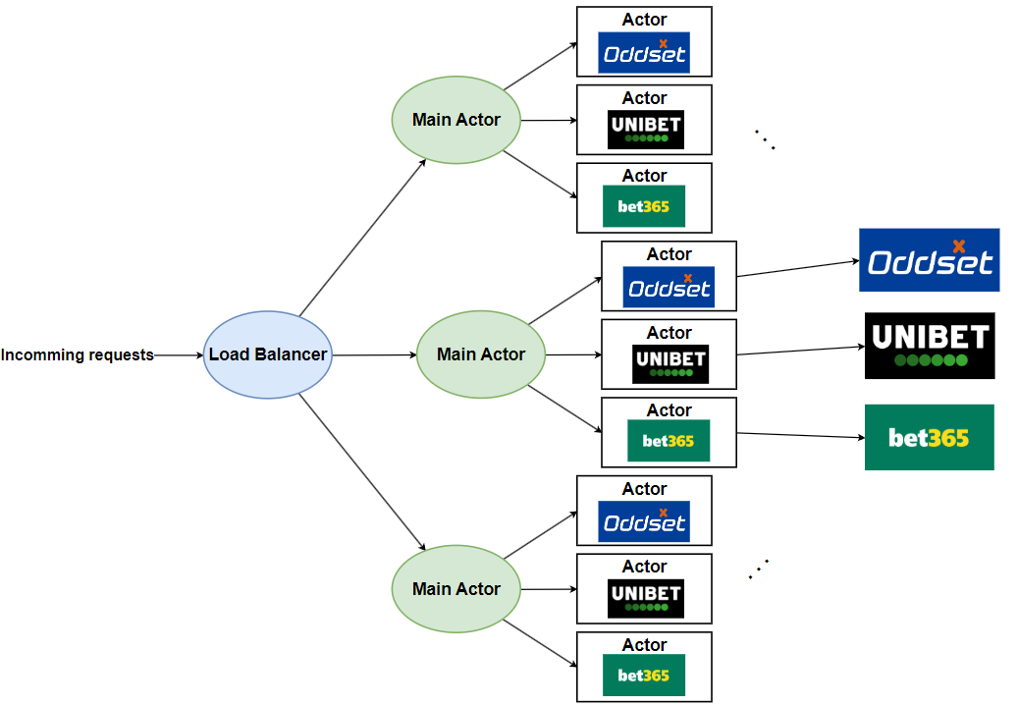
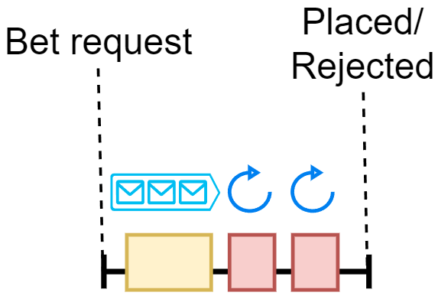
Load balanced Actor Model
Notes:
Jacob

Slide 14
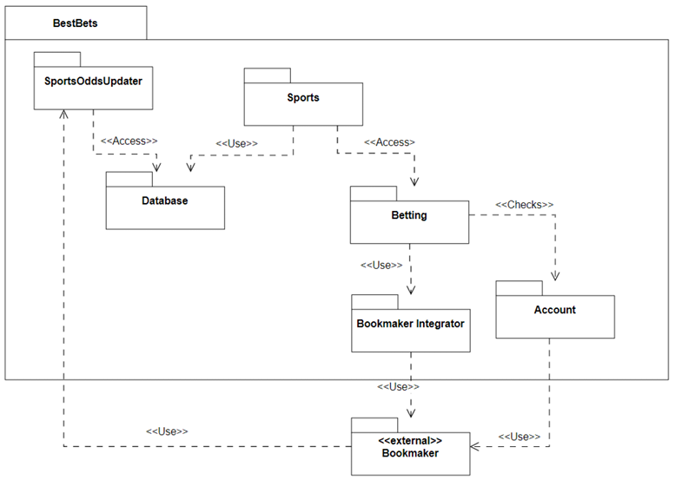
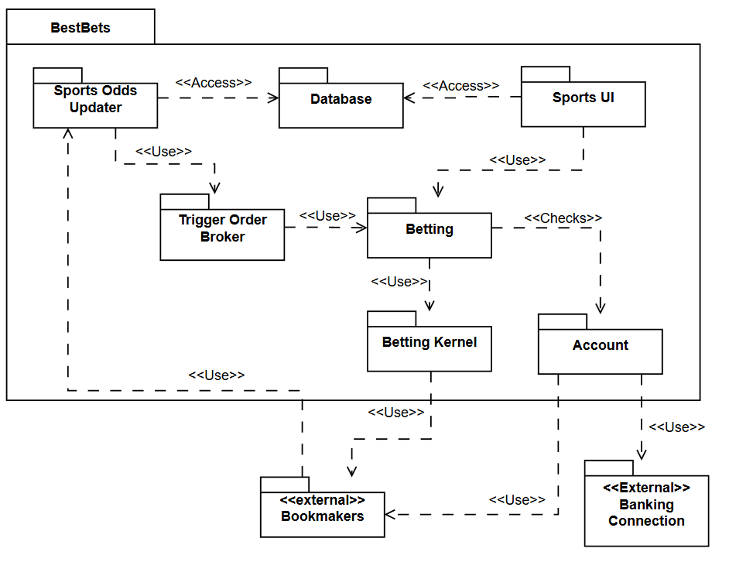
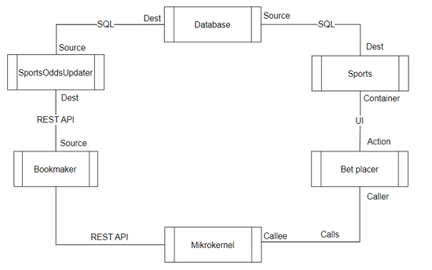
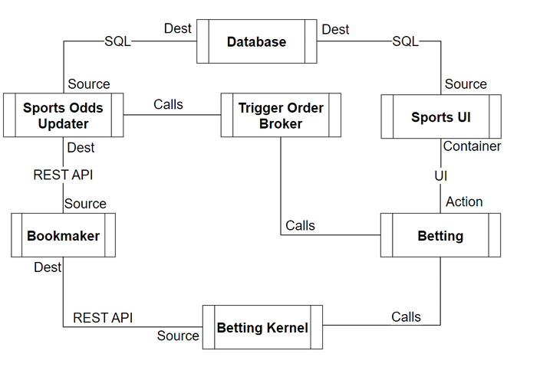
Iterative 3+1
Before Prototype
Final views
→
→
Notes:
As just presented, Prototype made us revisit our 3+1 views.
Bookmaker Integrator got more concrete -> Seperate Microkernel pattern
We added the Trigger Order Broker (from evaluation)

Slide 15

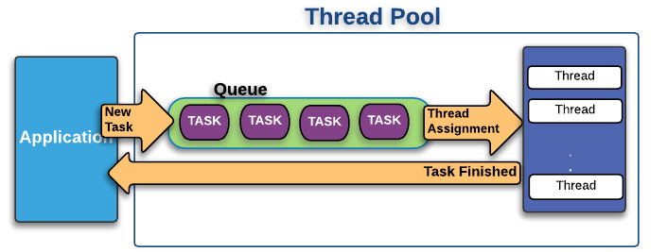
Alternative aproaches considered
Microservice structure?
Thread pool?
Notes:
Microservice instead of monolithic structure (Good modifiability, could help solve database concerns)
- Could still be an area of interest in fututure
Thread pool (Better performance and concurrency (instead of actor).
- Might hurt safety -> No fault isolation.

Slide 16


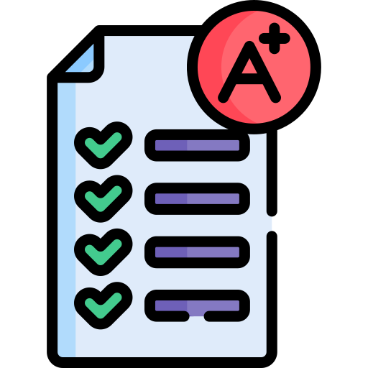
Evaluation with aSQA
ATAM or aSQA
2
Iterations
Scores
Notes:
ATAM (Architecture Trade-off Analysis Method) is heavy. aSQA (arch. software quality assurance) has iterative focus.
With aSQA. Easier to directly compare different suggstions.
We had two iterations: before and after improvement.
Some scored based on prototype. Rest are guesstimates. 1-5 from the literature. Architectural vs implementation perspective
Metrics were hard to define for guesstimates.
Two main modules. 3 components in first iteration. 2 in second.

Slide 17
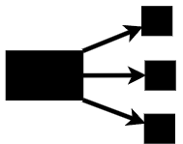
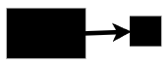
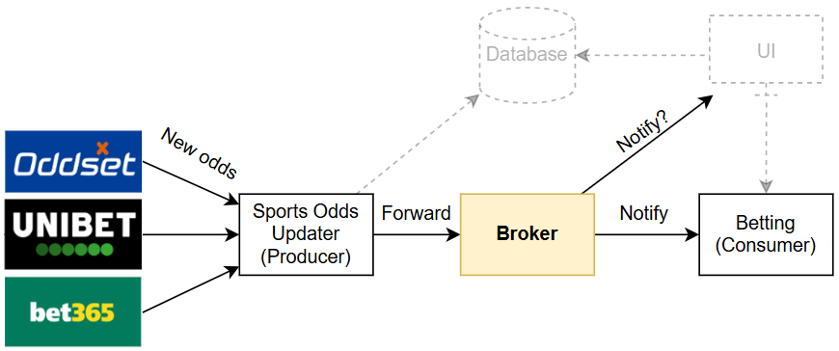
The broker
Global Odds Broker → Trigger Order Broker Target
Performance
Modifiability
2 3 4
2 4 3
Notes:
Global to trigger orders only.
The hidden trade-off. Now UI updates must be handled else-wise
Lower importance because it happens before users bet for money.

Slide 18

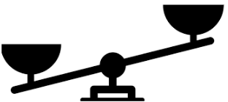
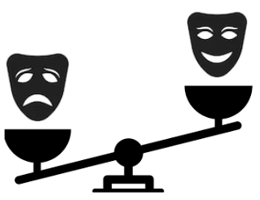
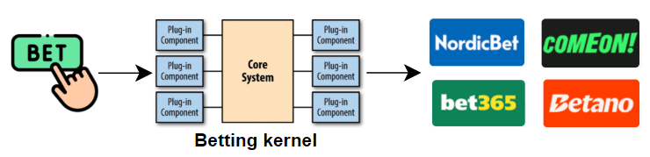
The Betting Kernel
Actor Model Load Balancer → Load Balanced Actor Model Target
Performance
Modifiability
Safety
2 5 5 5
5 4 3 4
4 1 4 4
Notes:
The initial tradeoff: Safety vs Performance.
The new trade-off. Performance and safety has higher importance. Lower modifiability
Higher importance than broker because this is where users place money

Slide 19
Thank you

